Slide 1

IDENTIFICATION OF CRIME PRONE AREAS
PSID: INTL-DA-07
Data analytics

Slide 2





Our team
Blitzkrieg
Ritunjay M
3rd year CSE
Team Leader
Munishkumar S
3rd year CSE
Team Member
Pradeep V
3rd year CSE
Team Member
Praveen Raagul R
3rd year CSE
Team Member
Ms. G. Janakasudha
Assistant Professor - CSE
Team Mentor

Slide 3

MOTIVATION STOP CRIMES BEFORE CRIMES STOP US
ML provides mechanisms for improving police knowledge of current and potential crimes and facilitating complex anti-criminal decision making.
In developed countries like USA, COMPSTAT and PREDPOL have already been used and crime rates have gone down drastically every year.

Slide 4
Problem statement
Build a solution for predictive policing that is able to identify areas where crimes are more likely to occur.
Also evaluate the sample data and suggest improvements, to the way data is currently captured and processed so as to enhance the quality of data.

Slide 5




Tech stack
Power Bi
MongoDB
Front-end & Data visualization
Future of data visualization
Occupies very less memory
Backend
Handles large unstructured data
Fast and quick
Python
Scikit Learn
K-Means clustering
Prediction and analysis
Importing ML models for future
Evaluation metrics

Slide 6
WORKFLOW
DATASET
FEATURE ENGINEERING
DATABASE
MODEL
VISUALIZATION
PREDICTION

Slide 7




Solution
DATA PRE-PROCESSING & FEATURE ENGINEERING
CRIME PREDICTION AND FORECASTING
VISUALIZATION
ANALYTICS AND REPORTING
BINNING
CONCATENATION
EMBEDDING
CLUSTERING (K-MEANS)
SPATIO-TEMPORAL APPROACH
ARIMA ALONG WITH LSTM
SIMPLIFIED USER EXPERIENCE CRIME STATISTICS DASHBOARD
YEARLY, MOTHLY, DAILY, HOURLY
CRIME COUNT GAUGE
LINE GRAPH, FUNNEL CHART, PIE CHART
HEAT MAP, CRIME MARKED ROAD MAPS
TIME PERIOD IN A DAY REPORTS
CRIME WISE & AREA WISE REPORTS COMPARISON OF REPORTS MONITORING OF CRIME RATE EFFECTIVE RESOURCE PLANNING
PREDICTIVE POLICING
FUTURE EXTENSION:

Slide 8
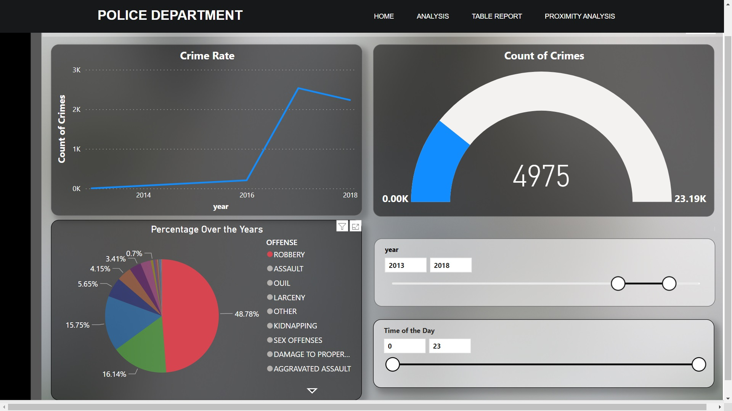

Slide 9
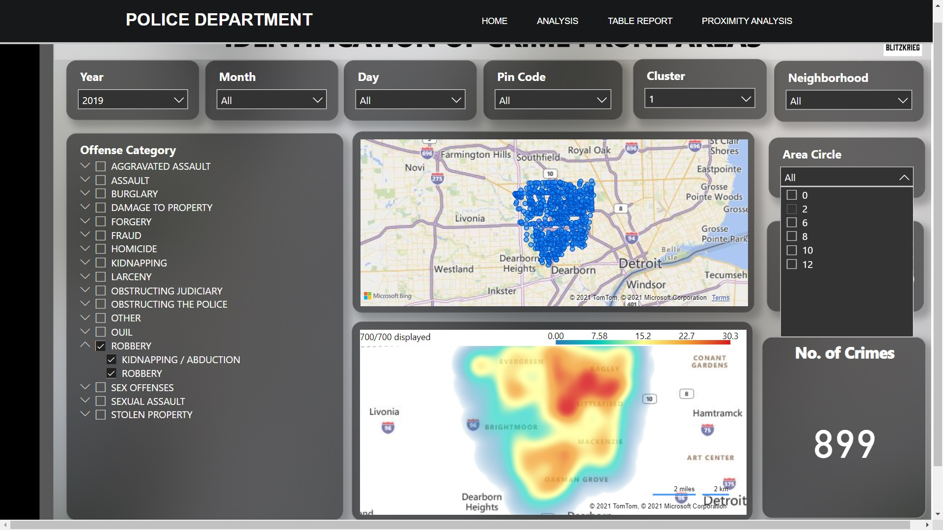

Slide 10
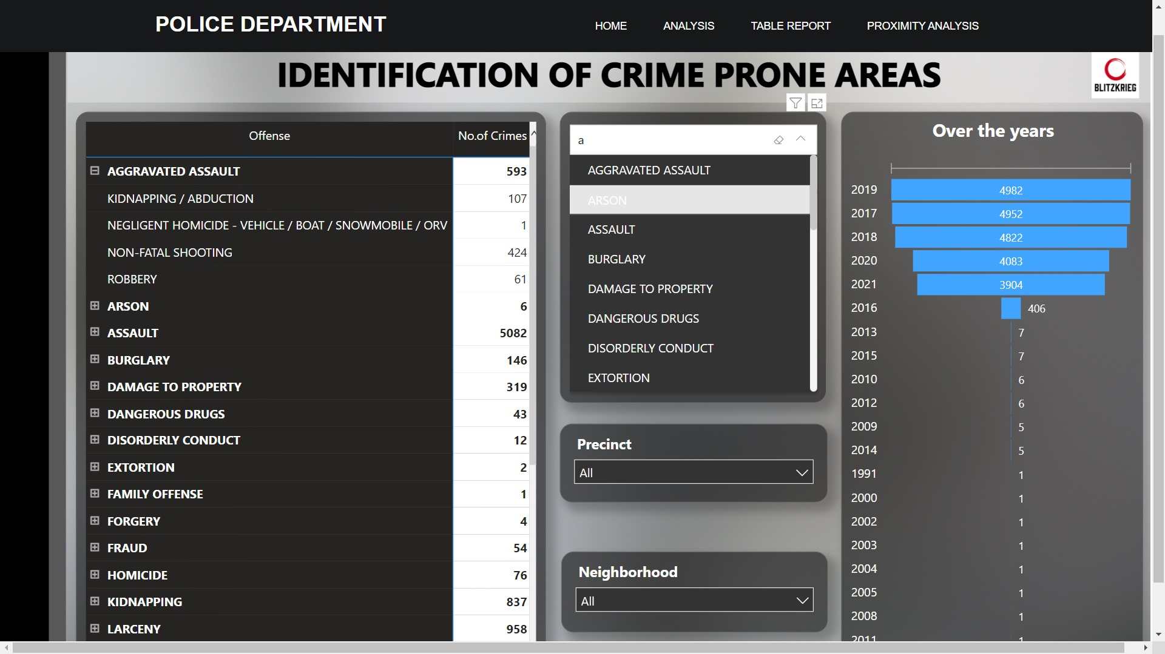

Slide 11
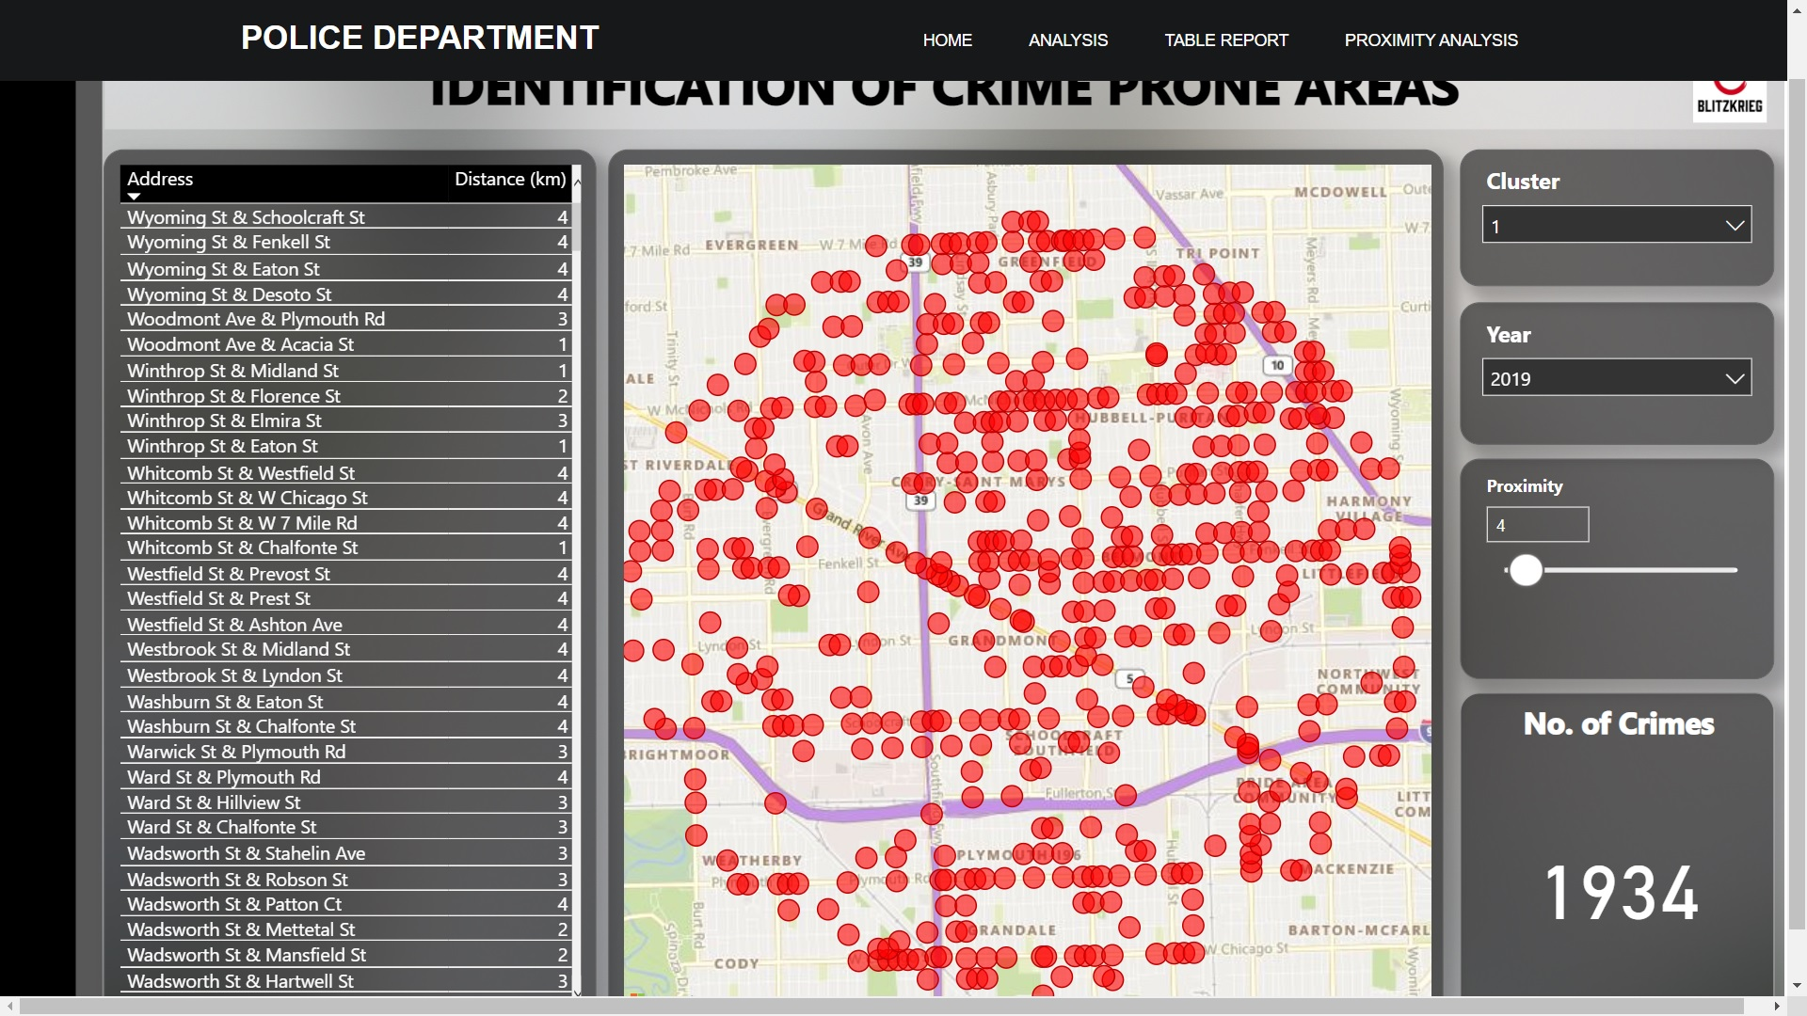

Slide 12
Data improvisation
PREMISE - Gas station, ATMs, Bus stand, School, Apartment
WEAPON USED - Guns, Knife, unarmed
PLACE – Inside, Outside
Details of the person who was affected by the crime
Details of the person who committed the crime
Location of Police stations (Latitude and Longitude)
Area covered by each police station (radius, circumference)
Resources (No. of policemen and jeeps available at the station)

Slide 13
Approach in Future
Spatio-temporal approach (CNN-LSTM)
Multi-variate time-series regression (ARIMA, S-ARIMA)
Embedding using GLOVE/BERT
If data is of high cardinality, then reduce feature complexity PCA
We can predict possible locations for a given crime at a given time and give even more information (details of the person who is about to commit the crime)
Our idea will give a proper lead for the police to patrol the area and safeguard the citizens from being affected

Slide 14
Two-year action plan
Get required​
Dataset from
the government
Finalizing
the feature extraction process
Complete designing
the prefect ML model
tailor-made for our usage
2022
Jan
Feb
Mar
Apr
May
Jun
Jul
Aug
Sep
Oct
Nov
Dec
Implement predictive policing​
Continually identifies crime prone areas
Crime rates
goes down effectively
2023
Jan
Feb
Mar
Apr
May
Jun
Jul
Aug
Sep
Oct
Nov
Dec

Slide 15

Thank you

